Slide 1
Introduction to R
Introduction to Data Science

Slide 2
Text/Reference Book
R IN ACTION: Data analysis and graphics with R – Robert I. Kabacoff

Slide 3
The R Project
R is a programming language. (interpreted and dynamic)
R is often used for statistical computing and graphical presentation to analyze and visualize data.
R was originally written by Ross Ihaka and Robert Gentleman, at the University of Auckland.

Slide 4
Why Use R?
It is a great resource for data analysis, data visualization, data science and machine learning
It provides many statistical techniques (such as statistical tests, classification, clustering and data reduction)
It is easy to draw graphs in R, like pie charts, histograms, box plot, scatter plot, etc.
It works on different platforms (Windows, Mac, Linux)
It is open-source and free
It has many packages (libraries of functions) that can be used to solve different problems

Slide 5
How to Install R and RStudio
Download and install R (https://cloud.r-project.org/ ) download the latest version of R for Windows, Mac or Linux.
Then download and install R Studio go to https://www.rstudio.com/products/rstudio/download/
Now you can open R Studio and start coding.

Slide 6
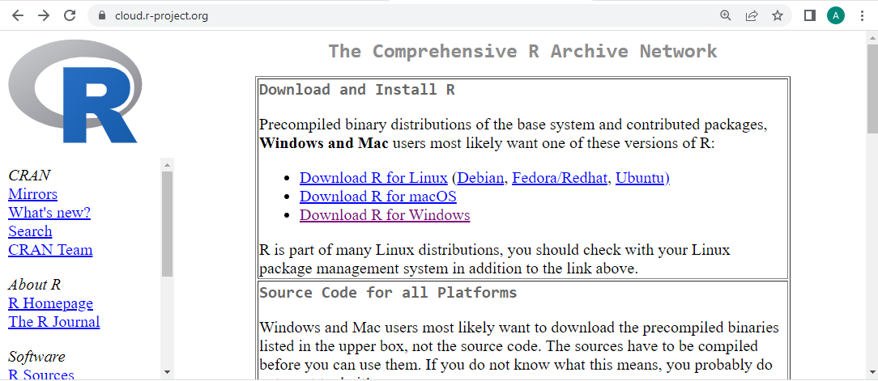
Installing R

Slide 7
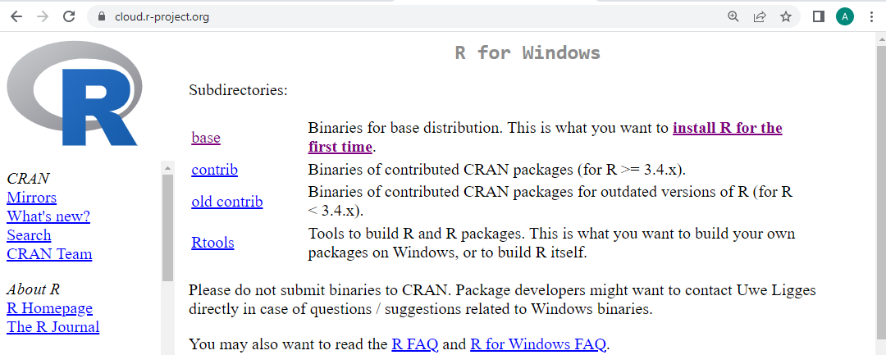
Installing R

Slide 8
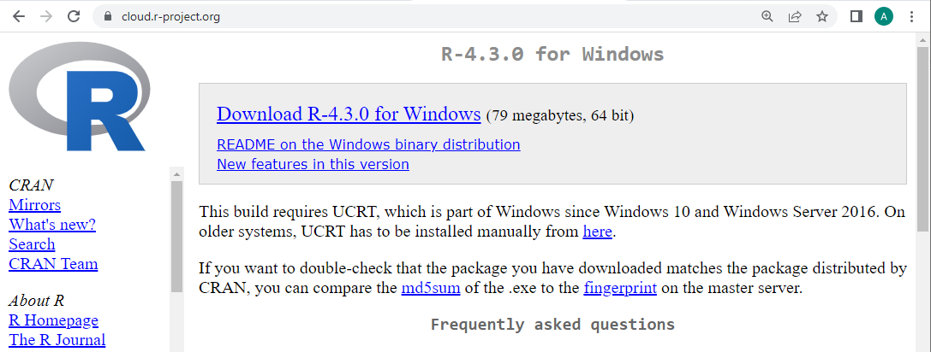
Installing R

Slide 9
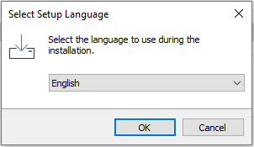
Installing R

Slide 10
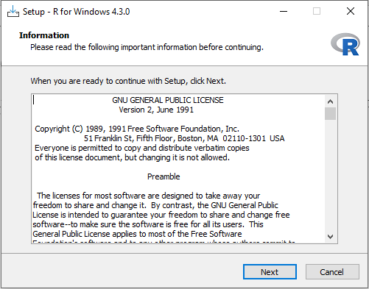
Installing R

Slide 11
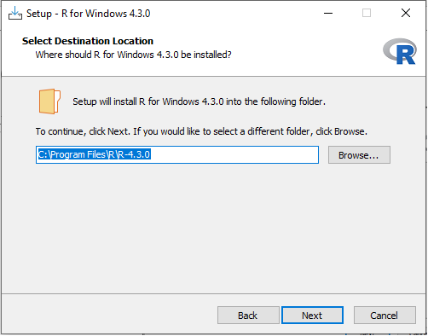
Installing R

Slide 12
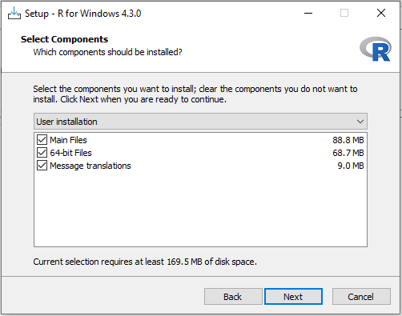
Installing R

Slide 13
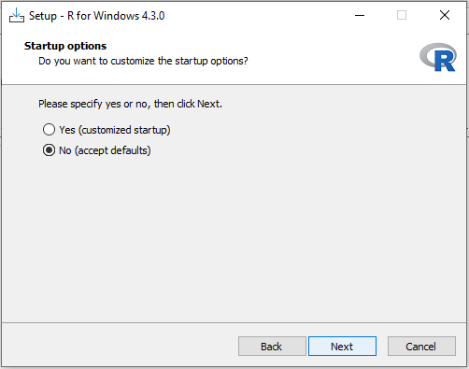
Installing R

Slide 14
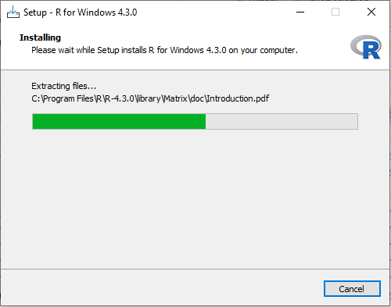
Installing R

Slide 15
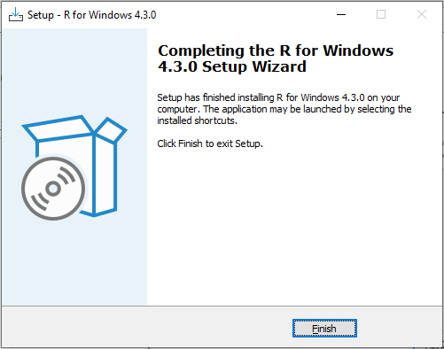
Installing R

Slide 16
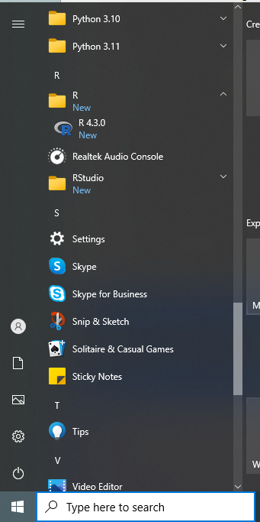

Checking Installation
Notes:
If you are using a Windows PC, there are two ways you can check whether R is already installed on your computer:
Check if there is an “R” icon on the desktop of the computer that you are using. If so, double-click on the “R” icon to start R. If you cannot find an “R” icon, try step 2 instead.
Click on the “Start” menu at the bottom left of your Windows desktop, and then move your mouse over “All Programs” in the menu that pops up. See if “R” appears in the list of programs that pops up. If it does, it means that R is already installed on your computer, and you can start R by selecting “R” (or R X.X.X, where X.X.X gives the version of R, eg. R 2.10.0) from the list.
If either (1) or (2) above does succeed in starting R, it means that R is already installed on the computer that you are using. (If neither succeeds, R is not installed yet).
https://a-little-book-of-r-for-time-series.readthedocs.io/en/latest/src/installr.html

Slide 17
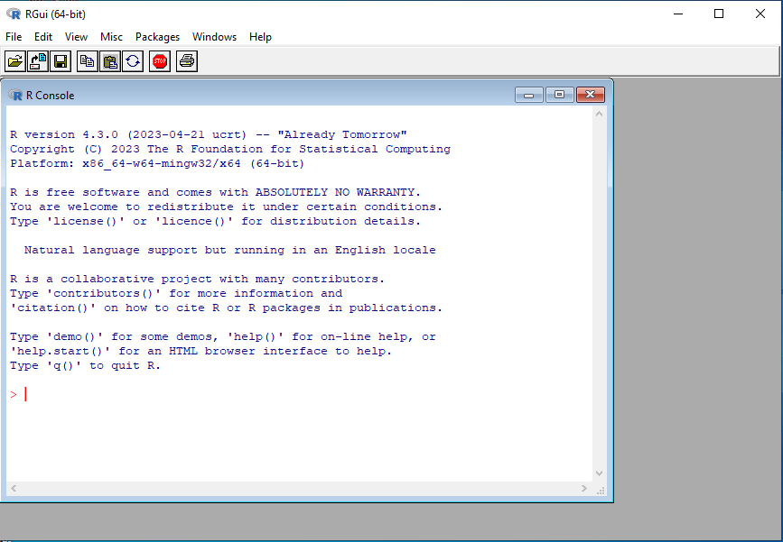
Checking Installation

Slide 18
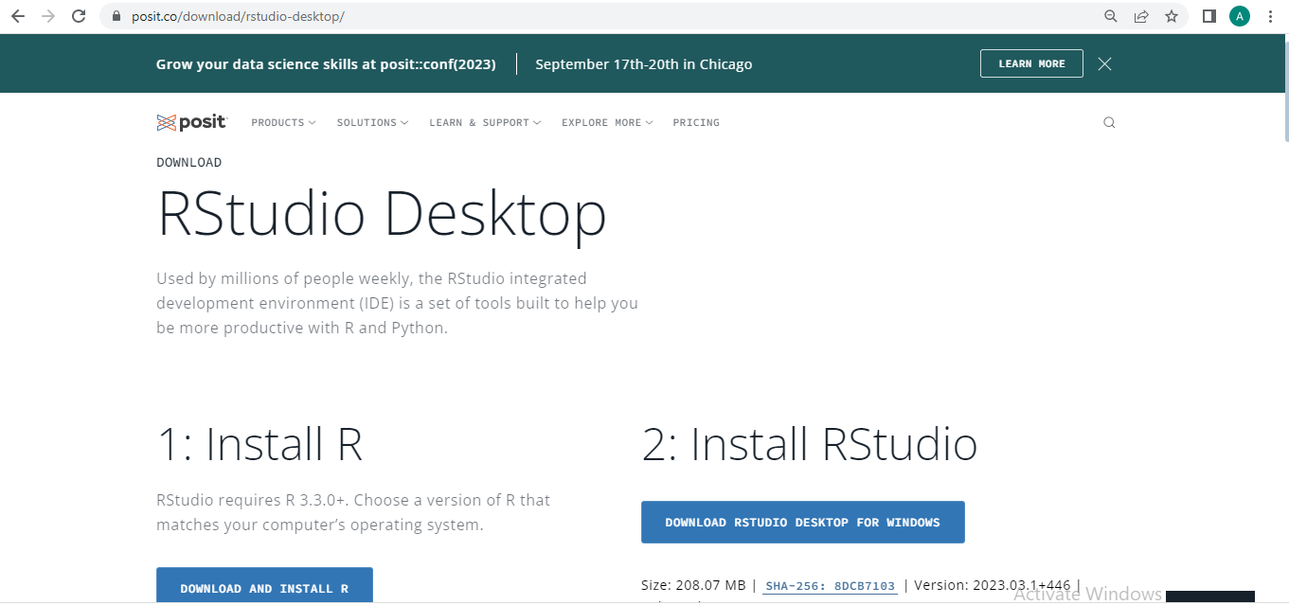
Installing RStudio

Slide 19
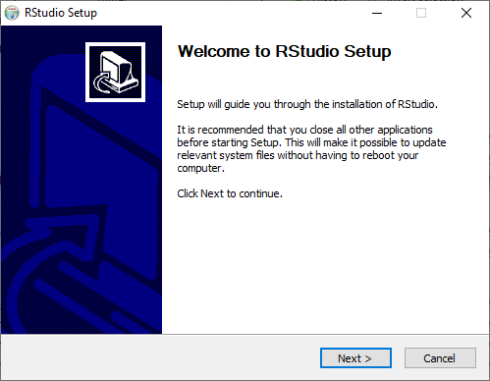
Installing RStudio

Slide 20
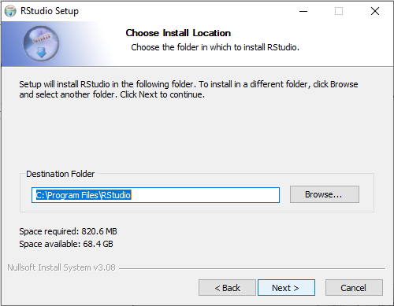
Installing RStudio

Slide 21
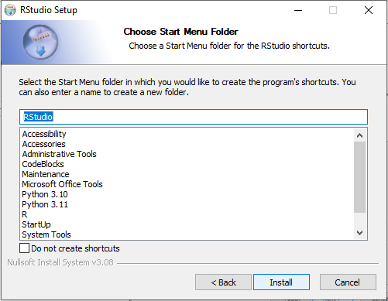
Installing RStudio

Slide 22
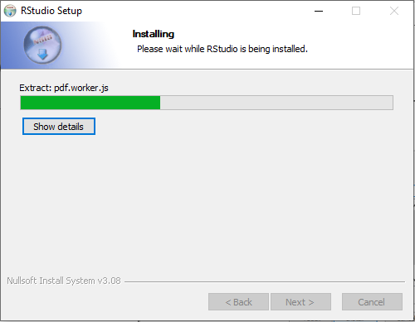
Installing RStudio

Slide 23
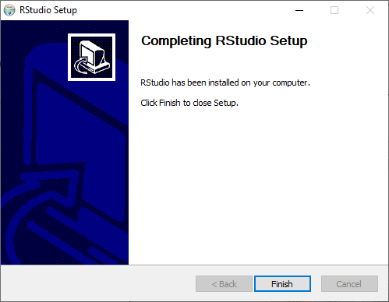
Installing RStudio

Slide 24
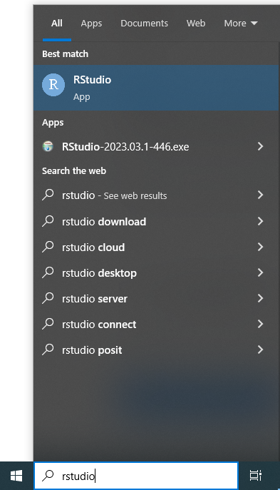
Checking Installation

Slide 25
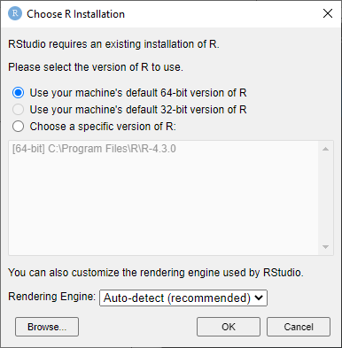
Checking Installation

Slide 26
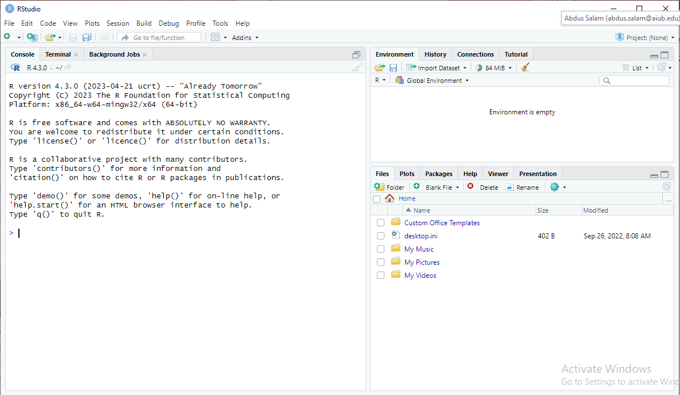
Checking Installation

